Slide 1
SQL
Data Definition
Basic Query Structure
Set Operations
Aggregate Functions
Null Values
Nested Subqueries
Complex Queries
Views
Modification of the Database
Joined Relations**

Slide 2
Data Definition Language
Allows the specification of:
The schema for each relation, including attribute types.
Integrity constraints
Authorization information for each relation.
Non-standard SQL extensions also allow specification of
The set of indices to be maintained for each relations.
The physical storage structure of each relation on disk.

Slide 3
Create Table Construct
An SQL relation is defined using the create table command:
create table r (A₁ D₁, A₂ D₂, ..., A_{n} D_{n}, (integrity-constraint₁), ..., (integrity-constraint_{k}))
r is the name of the relation
each A_{i} is an attribute name in the schema of relation r
D_{i} is the data type of attribute A_{i}
Example:
create table branch (branch_name char(15), branch_city char(30), assets integer)

Slide 4
Domain Types in SQL
char(n). Fixed length character string, with user-specified length n.
varchar(n). Variable length character strings, with user-specified maximum length n.
int. Integer (a finite subset of the integers that is machine-dependent).
smallint. Small integer (a machine-dependent subset of the integer domain type).
numeric(p,d). Fixed point number, with user-specified precision of p digits, with n digits to the right of decimal point.
real, double precision. Floating point and double-precision floating point numbers, with machine-dependent precision.
float(n). Floating point number, with user-specified precision of at least n digits.

Slide 5
Integrity Constraints on Tables
not null
primary key (A₁, ..., A_{n} )
Example: Declare branch_name as the primary key for branch
create table branch (branch_name char(15), branch_city char(30) not null, assets integer, primary key (branch_name))
primary key declaration on an attribute automatically ensures not null in SQL-92 onwards, needs to be explicitly stated in SQL-89

Slide 6
Basic Insertion and Deletion of Tuples
Newly created table is empty
Add a new tuple to account
insert into account values ('A-9732', 'Perryridge', 1200)
Insertion fails if any integrity constraint is violated
Delete all tuples from account
delete from account
Note: Will see later how to delete selected tuples

Slide 7
Drop and Alter Table Constructs
The drop table command deletes all information about the dropped relation from the database.
The alter table command is used to add attributes to an existing relation:
alter table r add A D
where A is the name of the attribute to be added to relation r and D is the domain of A.
All tuples in the relation are assigned null as the value for the new attribute.
The alter table command can also be used to drop attributes of a relation:
alter table r drop A
where A is the name of an attribute of relation r
Dropping of attributes not supported by many databases

Slide 8
FUNCTIONAL ANALYSIS
• Requirements are broken down into operations and sequences
• List of the transactions known to be required
• RESULT: High Level TRANSACTION SPECS
– Info needed for PHYSICAL DESIGN of DB

Slide 9
•APPLICATION PROGRAM DESIGN
Can plan LOGIC of programs without full knowledge of final DB design
• RESULT: Program Skeleton
TRANSACTION IMPLEMENTATION
• Requires at least CONCEPTUAL DB DESIGN
• RESULT: APPLICATION PROGRAMS

Slide 10
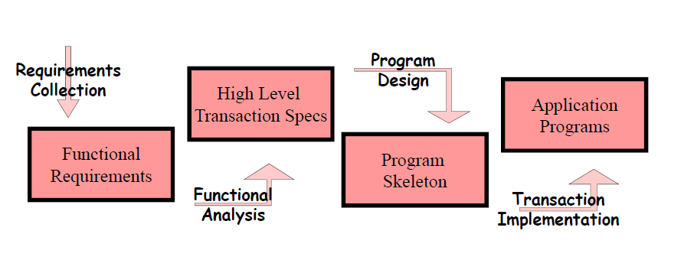
Operations Design Process

Slide 11
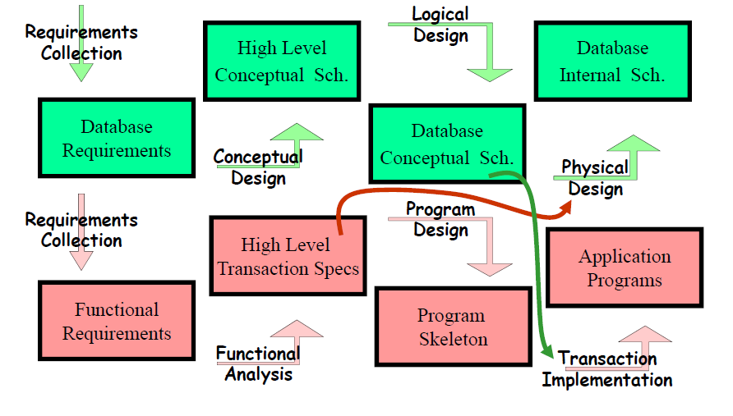
Combined Design Process

Slide 12
Data Models

Slide 13
Data Model
A database model defines the logical design of data. The model also describes the relationships between different parts of the data.
Various types of data models are:
Object oriented model
Hierarchical data model
Relational data model
Network model

Slide 14
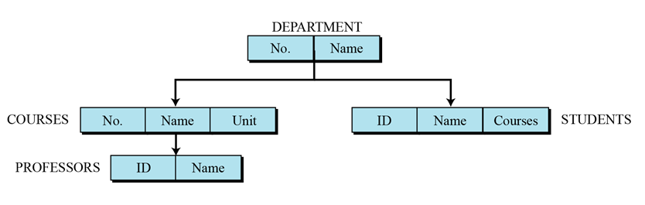
Data Models
Hierarchical data model: This is called a parent-child relationship. In this model each entity has only one parent but several children. At the top of the hierarchy there is only one entity which is called Root.

Slide 15
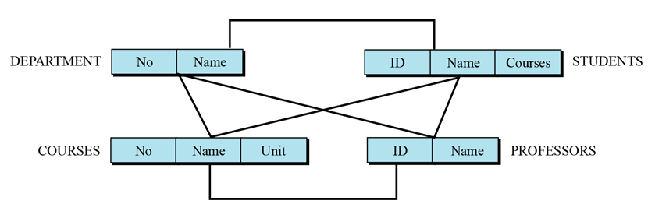
Data Models
Network model: In a network DBMS every data item can be related to many others ones. The database structure is like a graph. This is similar to the hierarchical model and also provides a tree-like structure. However, a child is allowed to have more than one parent.

Slide 16
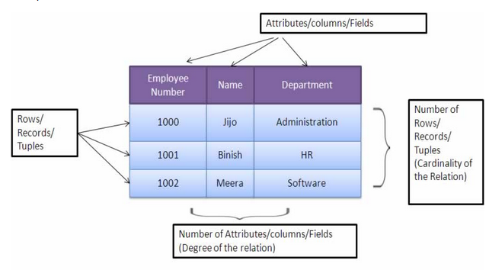
Data Models
Relational data model: In relational data model, data exists in two dimensional tables known as relations. A relation (table) consists of unique attributes (columns) and tuples (rows).

Slide 17
Data Models
Object oriented model: Object based data models use concepts such as entities, attributes, and relationships
The entity relational model( E-R model) has emerged as one of the main techniques for modeling database design .

Slide 18
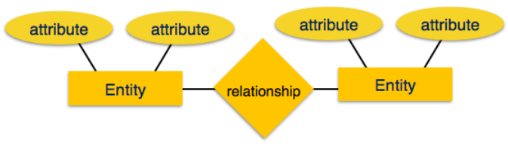
E-R Model
ER Model is based on:
Entities and their attributes
Relationships among entities

Slide 19
E-R Model components
Entity: An entity in ER Model is real world entity, which has some properties called attributes. Every attribute is defined by its set of values, called domain. For example, in a school database, a student is considered as an entity. Student has various attributes like name, age and class etc.
An entity set is a collection of similar types of entities. For example, Students set may contain all the student of a school.

Slide 20
Attributes
Attributes describe the properties of the entity of which they are associated.
A particular instance of an attribute is a value. For example, "Ram" is one value of the attribute Name.
We can classify attributes as following:
¨ Simple
¨ Composite
¨ Single-valued
¨ Multi-valued
¨ Derived

Slide 21
Simple attribute − Simple attributes are atomic values, which cannot be divided further.
For example, a student's phone number is an atomic value of 10 digits.
Composite attribute − Composite attributes are made of more than one simple attribute.
For example, a student's complete name may have first_name and last_name.

Slide 22
Single-Valued Attributes. An attribute is considered single-valued if there is at most one value associated with it at any one point in time. For example, suppose "gender" is an attribute in our design.
Multi-value attributes may contain more than one values. For example, a person can have more than one phone number, email_address, etc.
Derived Attribute : Attributes derived from other stored attribute. For example age from Date of Birth and Today’s date.

Slide 23
E-R model
E-R diagrams are used to model real-world objects like a person, a car, a company etc. and the relation between these real-world objects. An e-r diagram has following features:
E-R diagrams are used to represent E-R model in a database, which makes them easy to be converted into relations (tables).
E-R diagrams provide the purpose of real-world modeling of objects which makes them intently useful.
E-R diagrams require no technical knowledge & no hardware support.
These diagrams are very easy to understand and easy to create even by a naive user.
It gives a standard solution of visualizing the data logically.

Slide 24
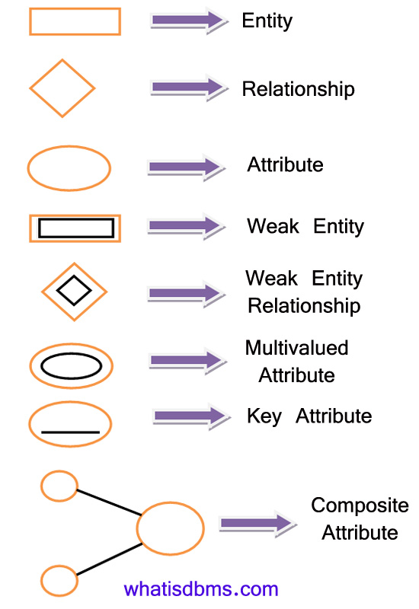
E-R Model: Symbols and notations

Slide 25
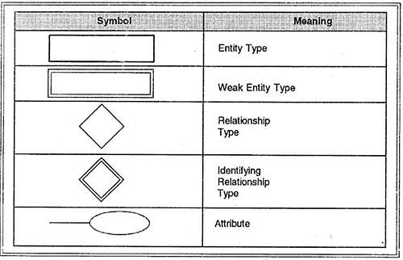
E-R Model: Symbols and notations

Slide 26
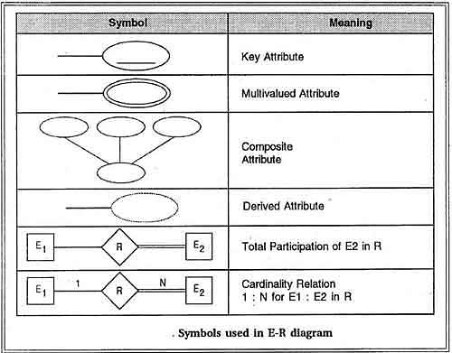
E-R Model: Symbols and notations

Slide 27
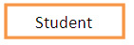
An E-R diagram constitutes of following Components
A. Entity:- Any real-world object can be represented as an entity about which data can be stored in a database. All the real world objects like a book, an organization, a product, a car, a person are the examples of an entity. Any living or non-living objects can be represented by an entity. An entity is symbolically represented by a rectangle enclosing its name.

Slide 28
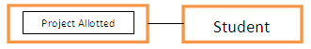
Two types of entity:
Strong entity: A strong entity has a primary key attribute which uniquely identifies each entity. Symbol of strong entity is same as an entity.
Weak entity: A weak entity does not have a primary key attribute and depends on other entity via a foreign key attribute.

Slide 29
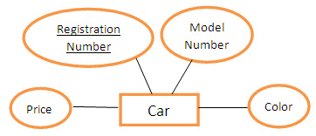
Attribute:- Each entity has a set of properties. These properties of each entity are termed as attributes. For example, a car entity would be described by attributes such as price, registration number, model number, color etc. Attributes are indicated by ovals in an e-r diagram.

Slide 30
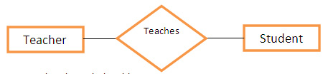
Relationships:- A relationship is defined as bond or attachment between 2 or more entities. Normally, a verb in a sentence signifies a relationship.
For example,
An employee assigned a project.
Teacher teaches a student.
Author writes a book.
A diamond is used to symbolically represent a relationship in the e-r diagram.

Slide 31
E-R Model
Relationship: The association among entities is called relationship. For example, employee entity has relation works_at with department.
Relationships are mapped with entities in various ways. Mapping cardinalities define the number of association between two entities.

Slide 32
Constraints
Various types of constraints are:
Mapping cardinalities
Participation constraints
Keys

Slide 33
Mapping Cardinalities
Mapping cardinality or cardinality ratios , express the number of entities to which another entity can be associated via a relationship set
Mapping cardinalities:
one to one
one to many
many to one
many to many

Slide 34
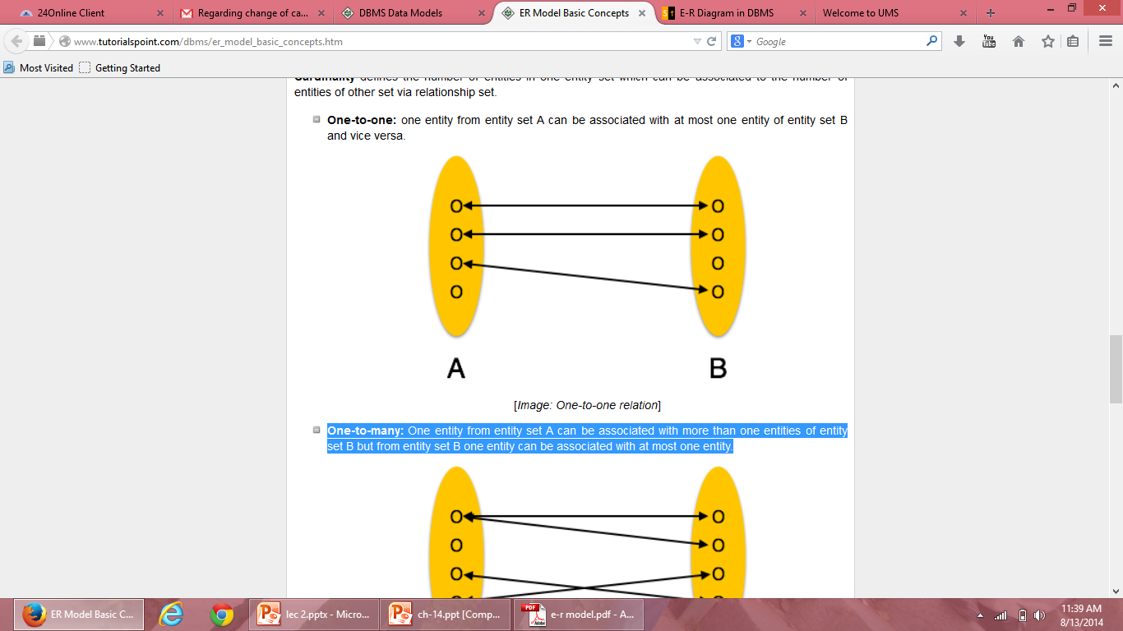
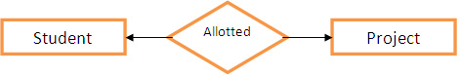
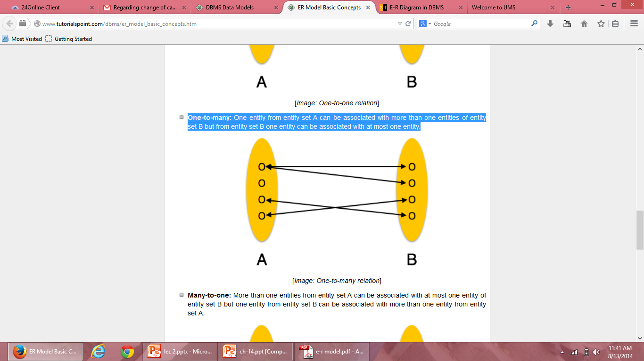
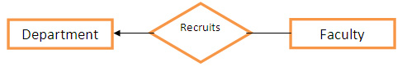
One-to-one: one entity from entity set A can be associated with at most one entity of entity set B and vice versa.
One-to-many: One entity from entity set A can be associated more than one entities of entity set B but from entity set B one entity can be associated with at most one entity.

Slide 35
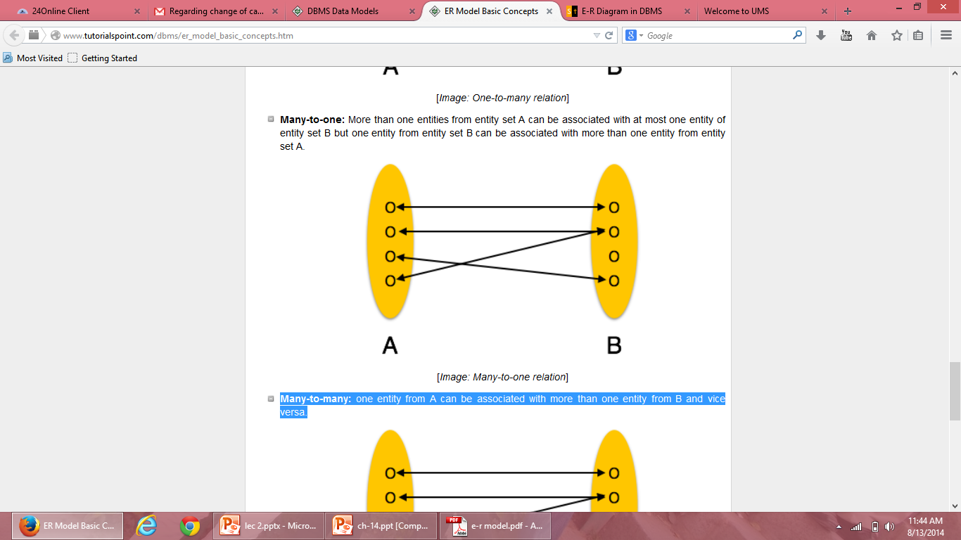
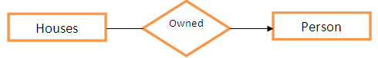
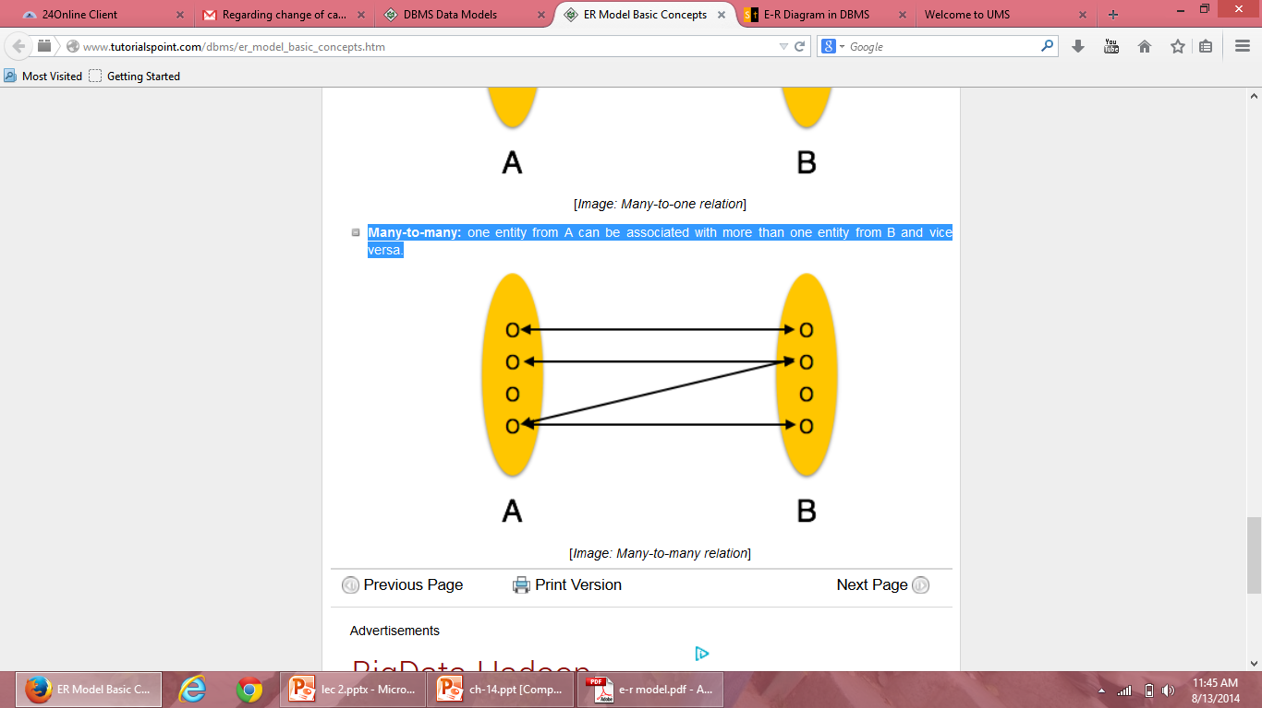
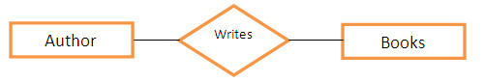
Many-to-one: More than one entities from entity set A can be associated with at most one entity of entity set B but one entity from entity set B can be associated with more than one entity from entity set A.
Many-to-many: one entity from A can be associated with more than one entity from B and vice versa.

Slide 36
Participation Constraints
The participation of an entity set E in a relationship set R is said to be total if every entity in E participates in at least one relationship in R.
If only some entities in E participate in relationships in R, the participation is said to be partial.

Slide 37
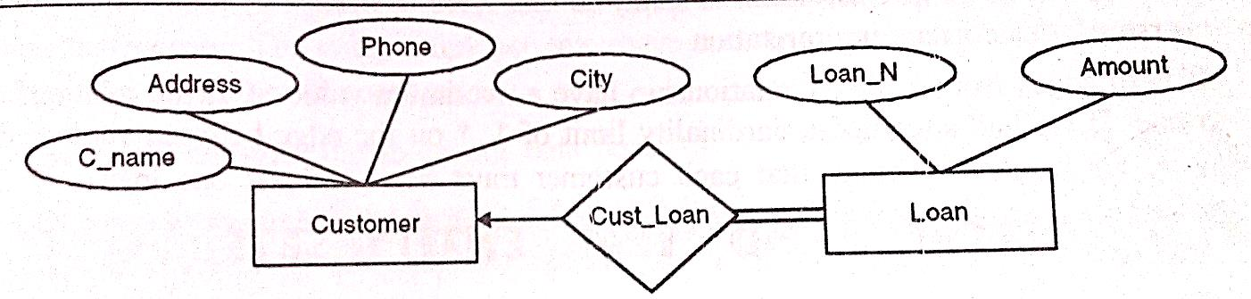
Example
borrower
Total participation of Loan entity

Slide 38
Types of Keys
Superkey: An attribute (or combination of attributes) that uniquely identifies each row in a table. It is a super set of candidate key.
Candidate key : An attribute (or set of attributes) that uniquely identifies a row. Let K be a set of attributes of relation R. Then K is a candidate key for R if it possess the following properties:
Uniqueness – No legal value of R ever contains two distinct tuples with the same value of K
Irreducibility- No proper subset of K has the uniqueness property

Slide 39
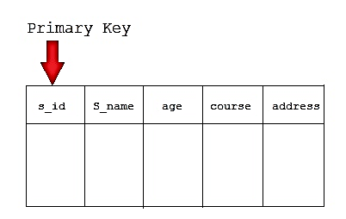
Types of Keys
3. Primary key : is the candidate key which is selected as the principal unique identifier. It is a key that uniquely identify each record in the table. Cannot contain null entries.

Slide 40
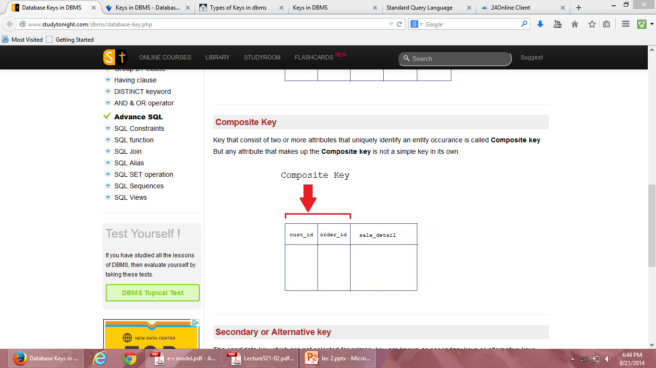
Types of Keys
4. Composite Key: Key that consist of two or more attributes that uniquely identifies an entity occurrence is called composite key.
Reg_no
Crs_id
subjects

Slide 41
Types of Keys
5. Foreign Key: A foreign key is generally a primary key from one table that appears as a field in another where the first table has a relationship to the second.
In other words, if we had a table A with a primary key X that linked to a table B where X was a field in B, then X would be a foreign key in B.

Slide 42
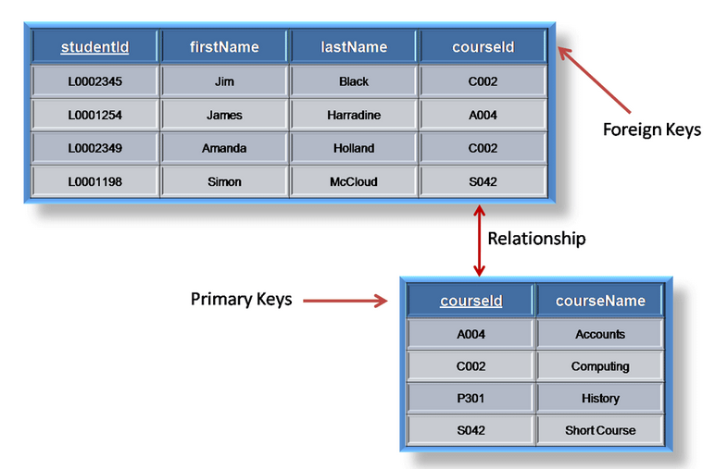
Example

Slide 43
Steps in designing E-R Diagram
There are following steps:
Identify the entities from the requirement sheets
Find relationships among those entities
Identify the key attributes for every entity
Identify other relevant attributes
Draw complete E-R diagram with all attributes including Primary key
Review your results with your Business users

Slide 44
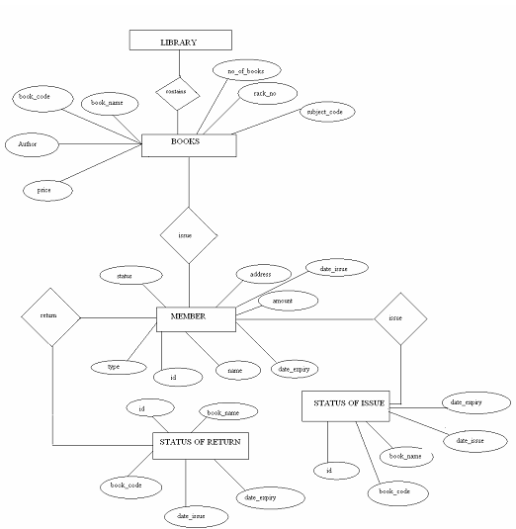
Library management system

Slide 45
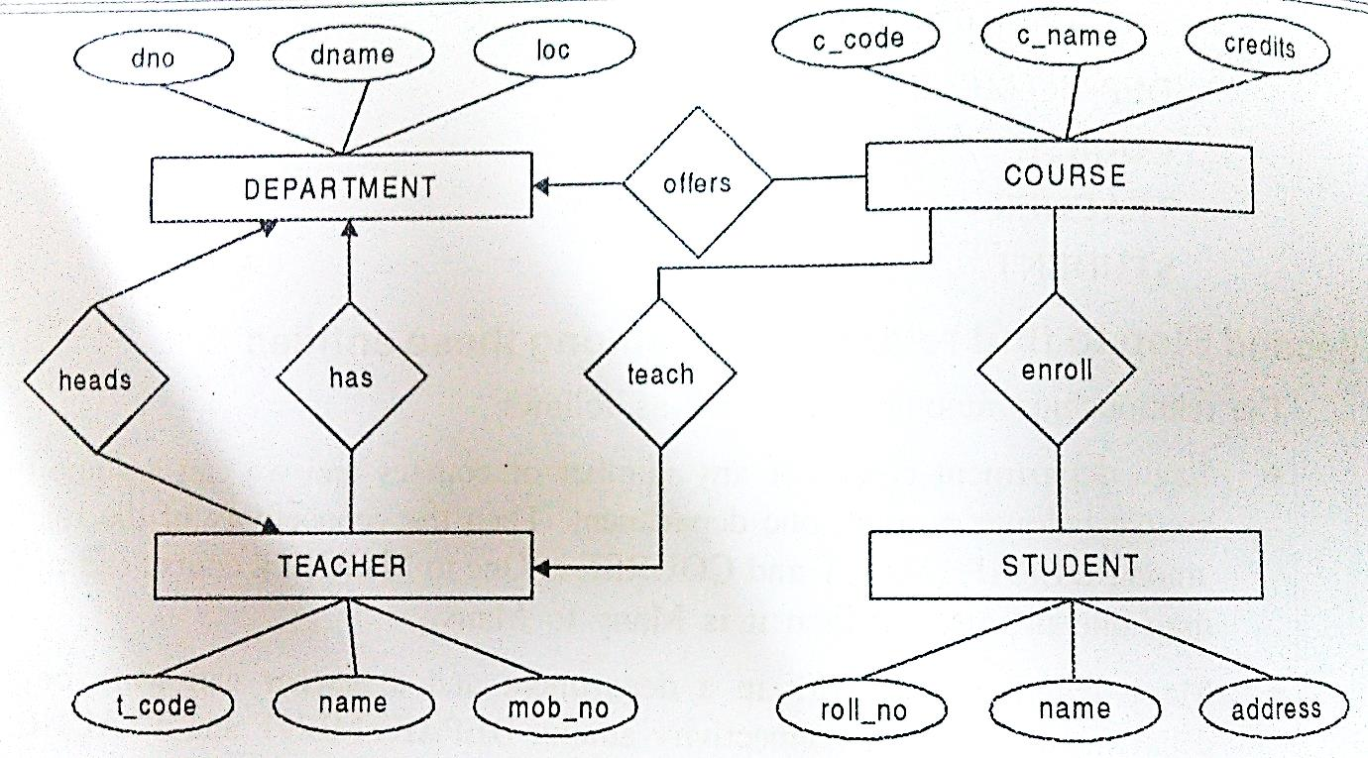
Example: University Management System

Slide 46
Keys
The key is defined as the column or attribute of the database table.
They are used to establish and identify relation between tables.
They also ensure that each record within a table can be uniquely identified by combination of one or more fields within a table.

Slide 47
Strong and Weak entity sets
The entity set which does not have sufficient attributes to form a primary key is called a Weak entity set.
The entity set which has the primary key is called as Strong entity set.
A member of a strong entity set is called dominant entity and member of a weak entity set is called subordinate entity.
Weak entity does not have a primary key but we need a mean to distinguish among other entities. The discriminator of a weak entity set is a set of attributes that allows this distinction to be made. Ex: payment_number.

Slide 48
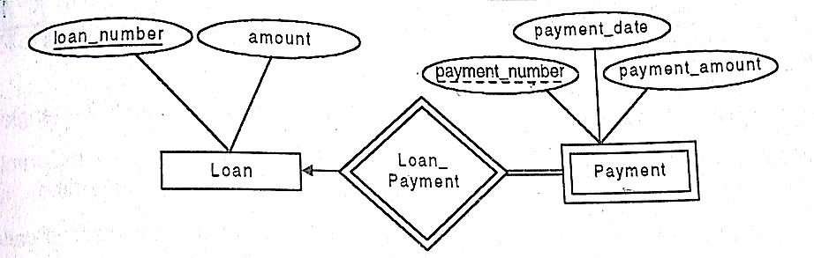
Example

Slide 49
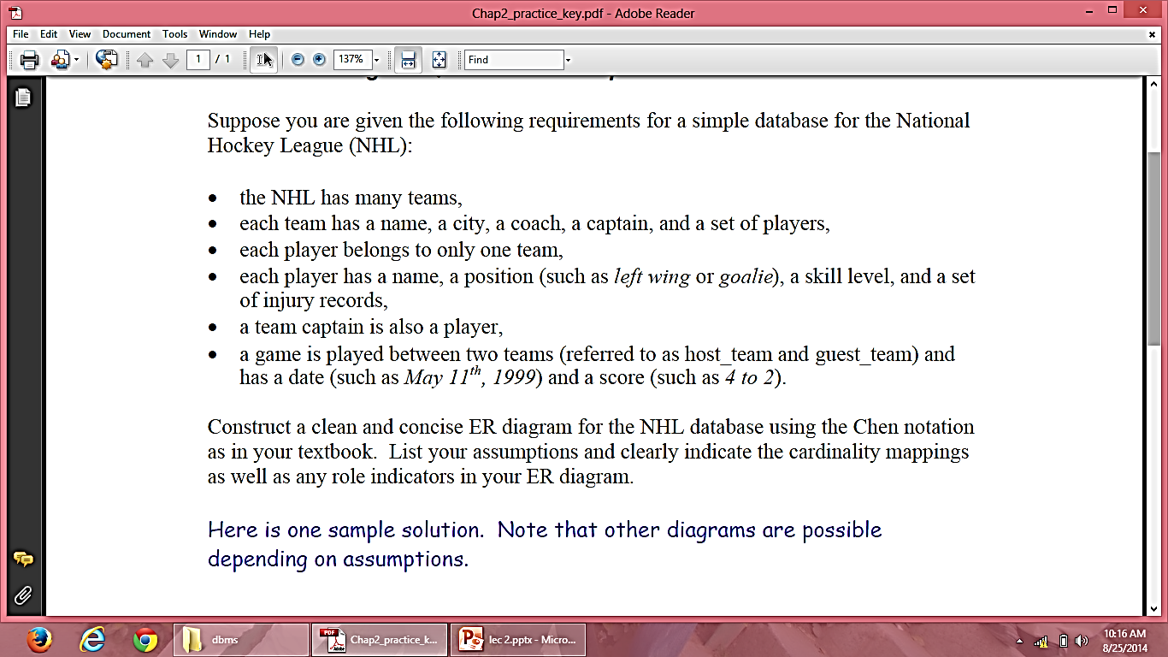
Example

Slide 50
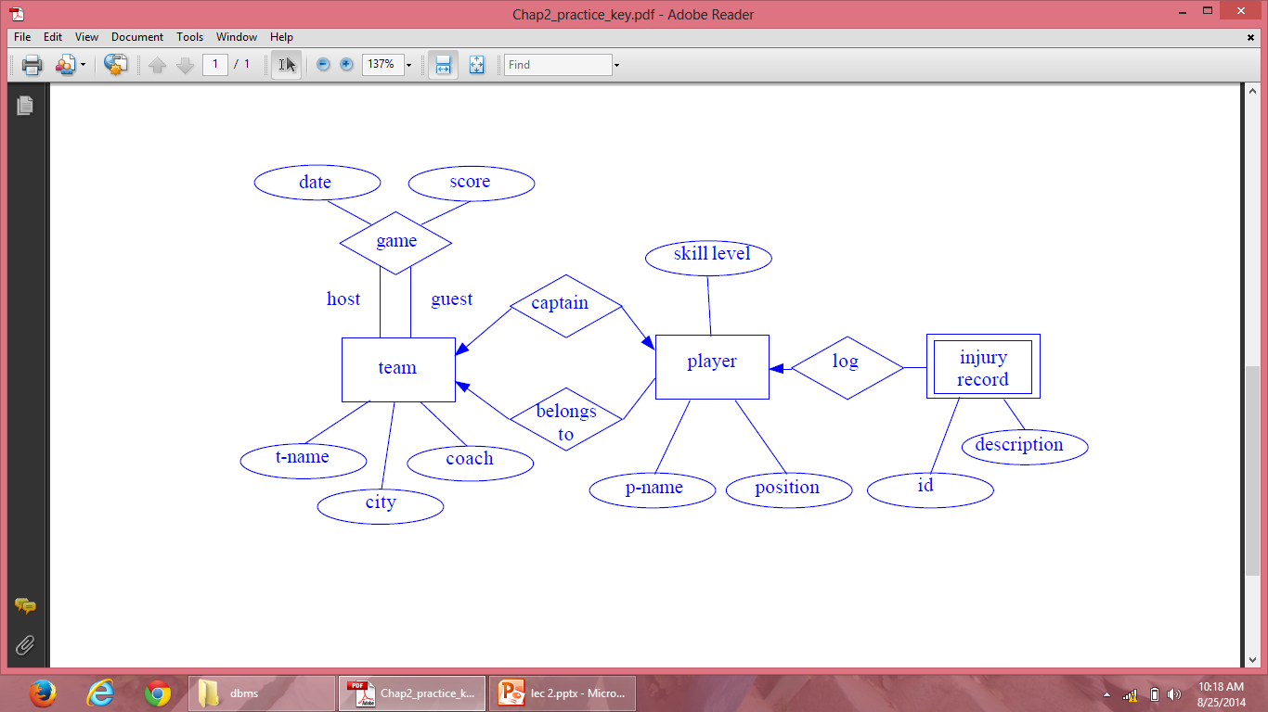
E-R Diagram

Slide 51
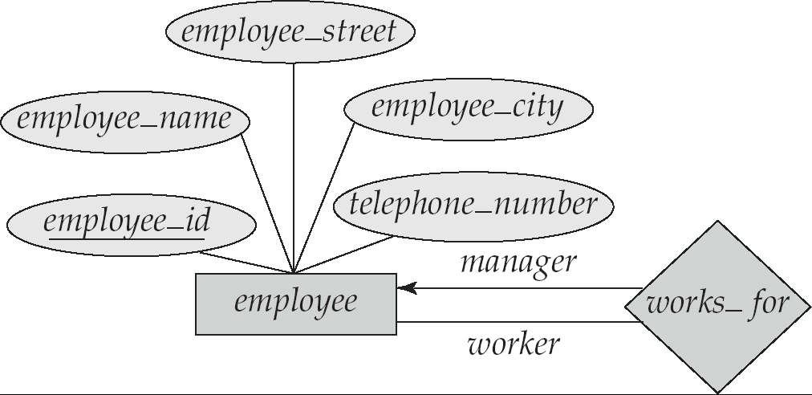
Roles
Entity sets of a relationship need not be distinct
The labels “manager” and “worker” are called roles; they specify how employee entities interact via the works_for relationship set.
Roles are indicated in E-R diagrams by labeling the lines that connect diamonds to rectangles.
Role labels are optional, and are used to clarify semantics of the relationship

Slide 52
Removing Redundant attributes in entity set
Once the entities and their corresponding attributes are chosen, the relationship sets among the various entities are formed.
These relationship sets may result in a situation where attributes in the various entity sets are redundant and need to be removed .
Consider the entity sets instructor and department
Instructor includes the attributes ID, name, dept_name, and salary with ID as primary key
Department includes the attributes dept_name, building, and budget with dept_name as primary key

Slide 53
Removing Redundant attributes in entity set
Attribute dept_name appears in both entity sets. It is primary key for entity department, it is redundant in the entity set instructor and needs to be removed.
If both entities have one to one relationship then we can remove it from instructor table as it will get added up in the relational schema of department.
But if an instructor has more than one associated department, the relationship between the entities is recorded in a separate relation inst_dept

Slide 54
Reduction to relational schema
Both E-R model and relational database model are abstract, logical representations of real-world enterprises.
Because the two models employ similar design we can convert an E-R design to relational design
E-R schema can be represented by relation schema in following ways:
Representing of strong entity sets with Simple Attributes
Representing of strong entity sets with Complex Attributes
Representation of weak entity sets
Representation of relationship sets

Slide 55
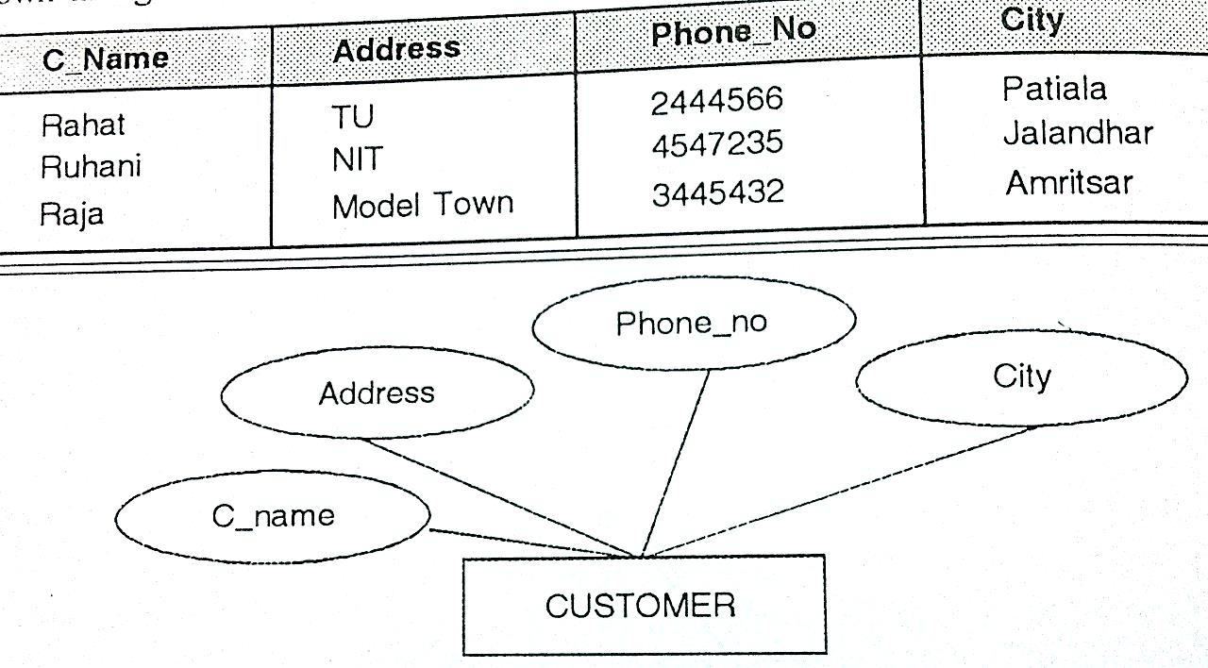
Representing of strong entity sets with Simple Attributes
A strong entity set reduces to a table with the same attributes as represented in E-R diagram

Slide 56
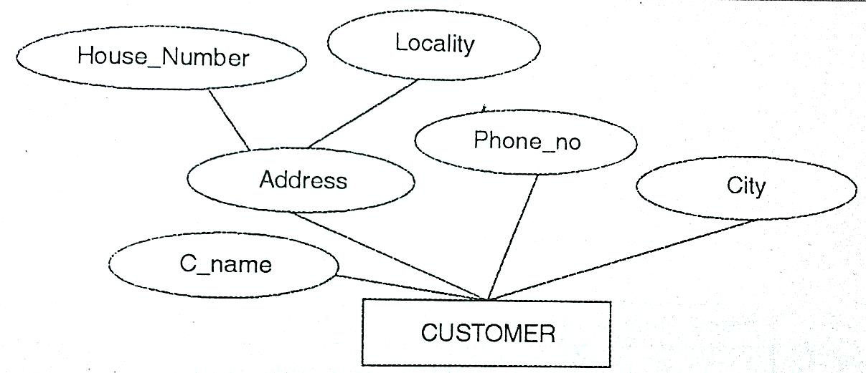
Representing of strong entity sets with Complex Attributes
In order to convert an entity having composite attributes, the composite attributes are flattened out by creating a separate attribute for each component attribute.

Slide 57
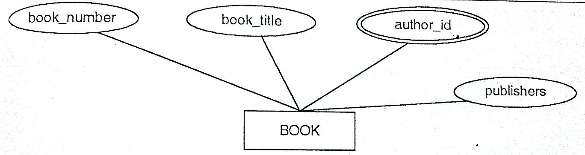
Multivalued attributes are treated differently from other attributes. New relation schemas are created for these attributes.
Derived attributes are not explicitly represented in the relational model.
BOOK entity set with author_id as multi-value attribute

Slide 58
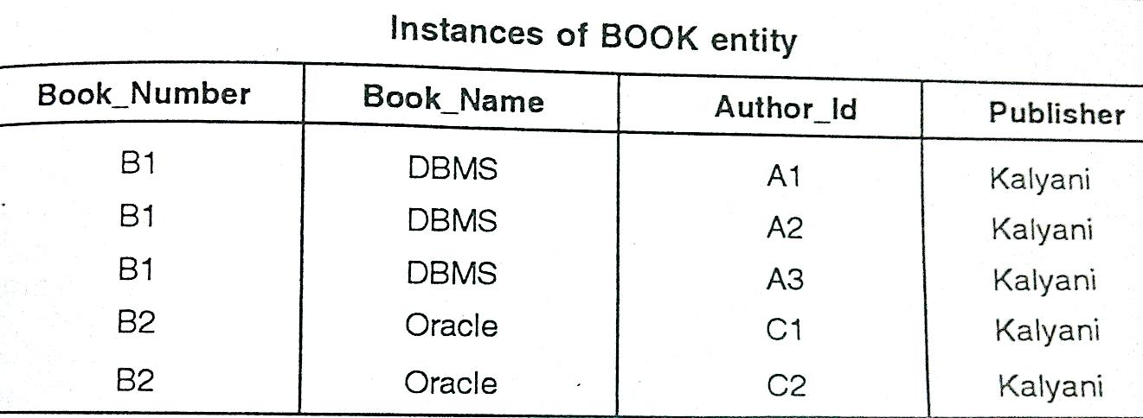
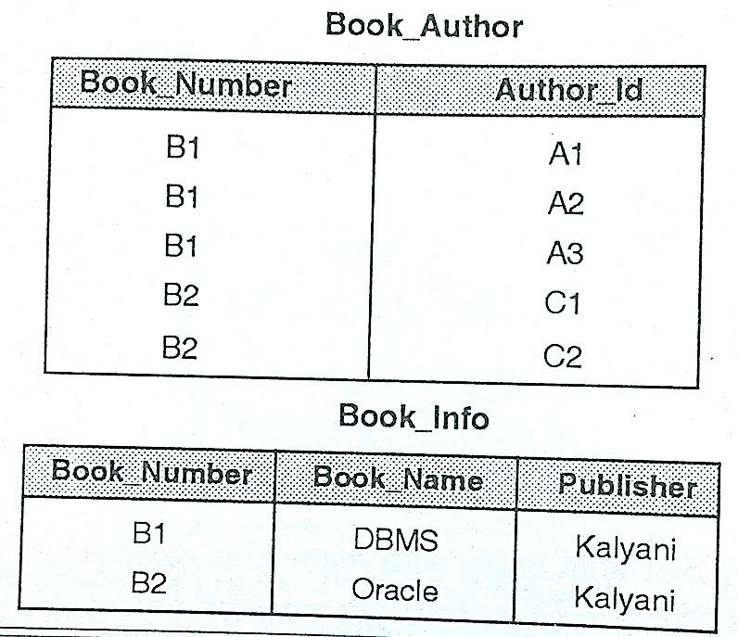

Slide 59
Representation of weak entity sets
For schemas derived from a weak entity set, the combination of the primary key of the strong entity set and the discriminator of the weak entity set serves as primary key of the schema.
payment = ( loan_number, payment_number, payment_date, payment_amount )

Slide 60
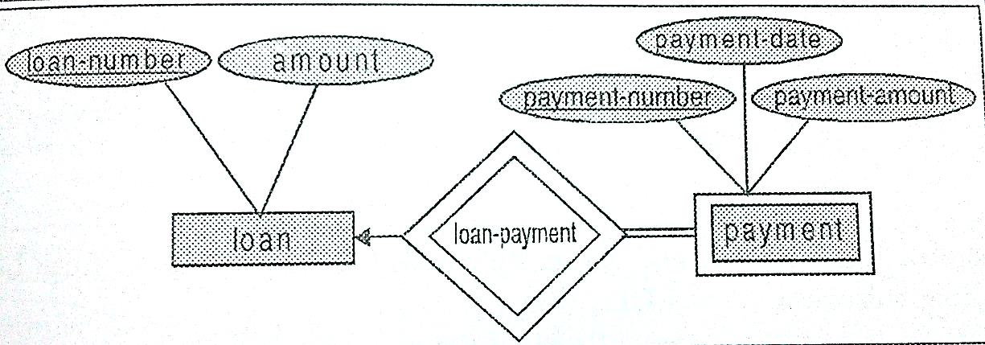
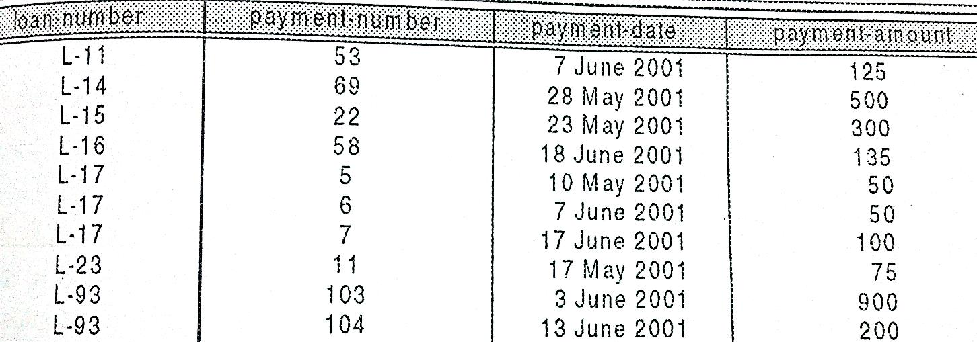

Slide 61
Representation of relationship sets
There are different strategies used for each type of relationship.
Conversion of many to many relationship to relational model:
A many to many relationship set is represented as a table with columns for the primary keys of the two participating entity sets, and the descriptive attributes of the relationship set.

Slide 62
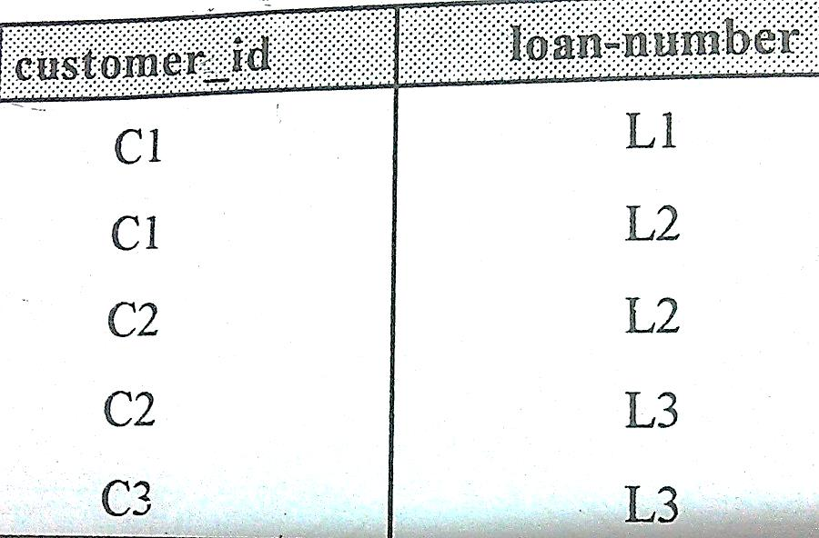
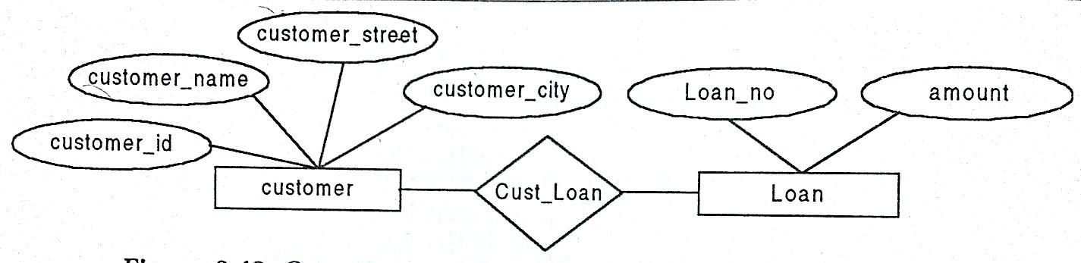

Slide 63
2. Conversion of one to many relationship to relational model:
For one to many or many to one relationship, there is no need to create the separate table for the relationship. Copy the primary key of entity set on one side of relationship into the entity set on “many” side of relationship.

Slide 64
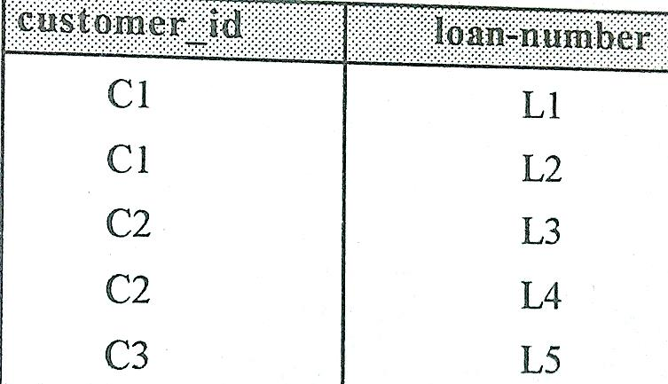
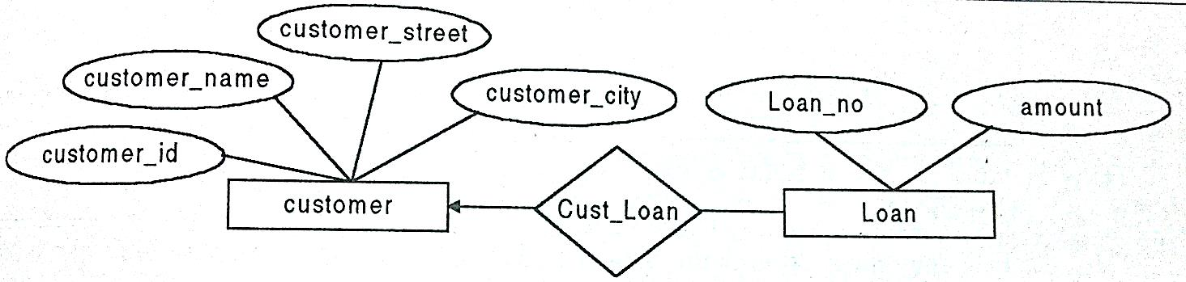
Customer and Loan relationship with 1:M type

Slide 65
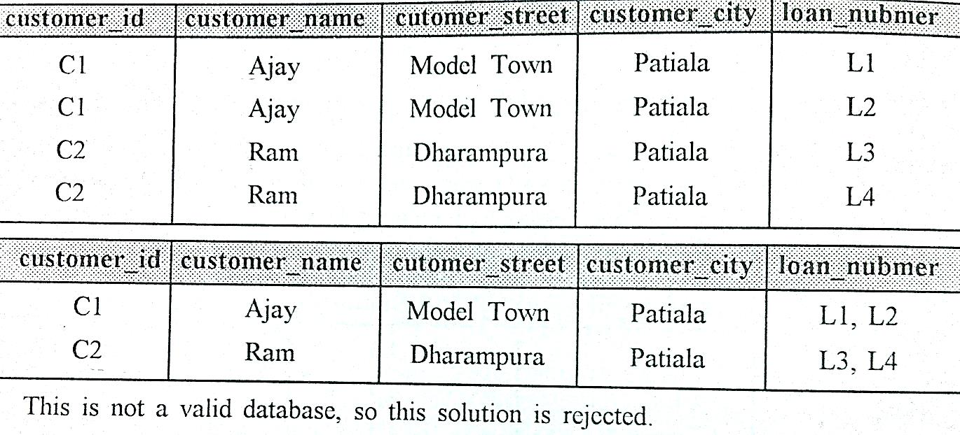
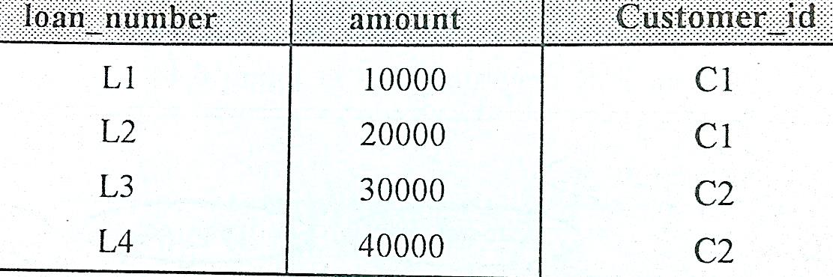

Slide 66
3. Conversion of one to one relationship to relational model:
In case of 1:1 relationship, there is no need to create a separate table for relationship and the primary key of any entity set can be moved to other side depending upon the requirement. It is preferable to copy the primary key of non-totally participated entity set towards totally participated entity set.

Slide 67
Design Issues
There are number of different ways to define set of entities and relationship among them. We examine basic issues in the design of an E-R model. These are:
Use of entity sets vs. attributes
Use of entity sets vs. relationship sets
Binary versus n-ary relationship sets
Placement of relationship attributes

Slide 68
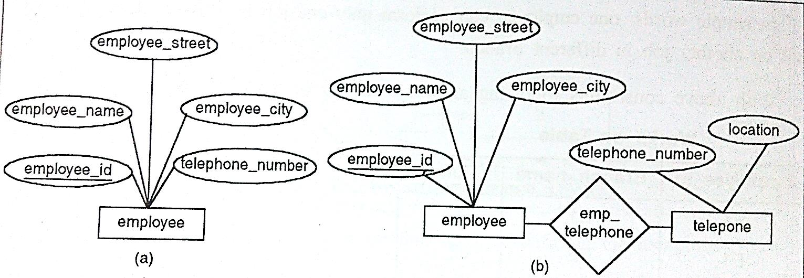
Design Issues: Use of entity sets vs. attributes
Treating telephone as an attribute telephone-number implies that employees have exactly one telephone number each
Treating telephone as an entity permits employees to have several telephone numbers associated with them.
The distinctions to consider an object as attribute or entity depends on the structure of real-world enterprise being modeled.

Slide 69
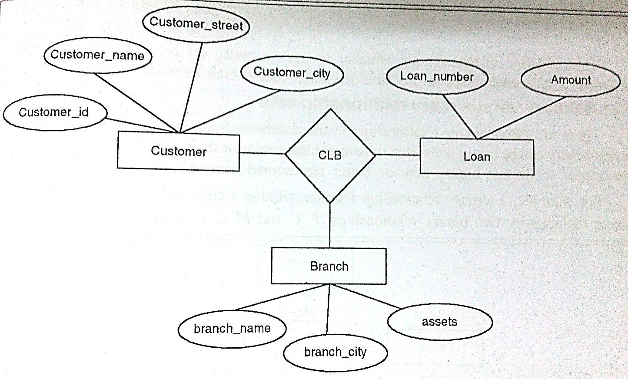
Design Issues: Use of entity sets vs. relationship sets
Each loan is represented by a relationship between a customer and a branch, if every loan is associated with exactly one customer and is associated with exactly one branch
If several customers hold a joint loan then, loan should be considered as an entity

Slide 70
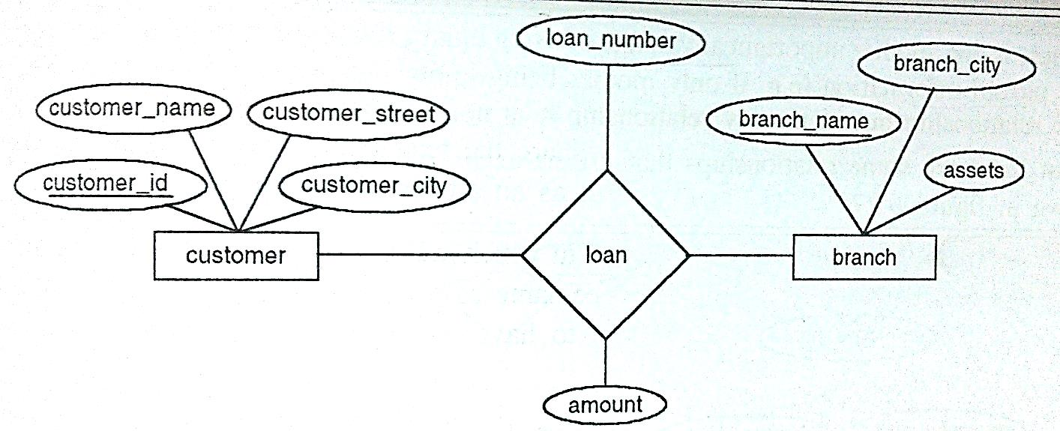
The guideline in determining whether to use an entity set or a relationship set is to designate a relationship set to describe an action that occurs between entities

Slide 71
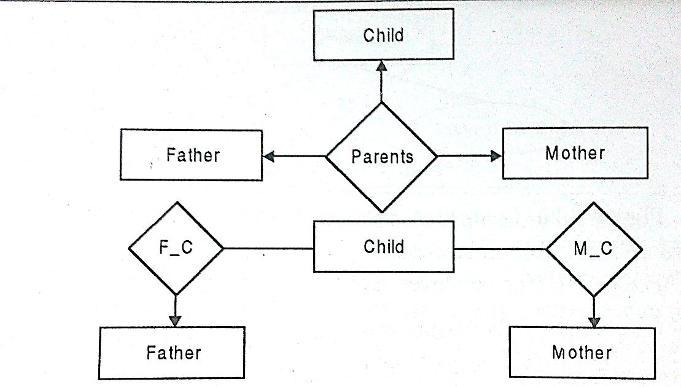
Design Issues: Binary versus n-ary relationship sets
Although it is possible to replace any nonbinary (n-ary, for n > 2) relationship set by a number of distinct binary relationship sets, a n-ary relationship set shows more clearly that several entities participate in a single relationship.

Slide 72
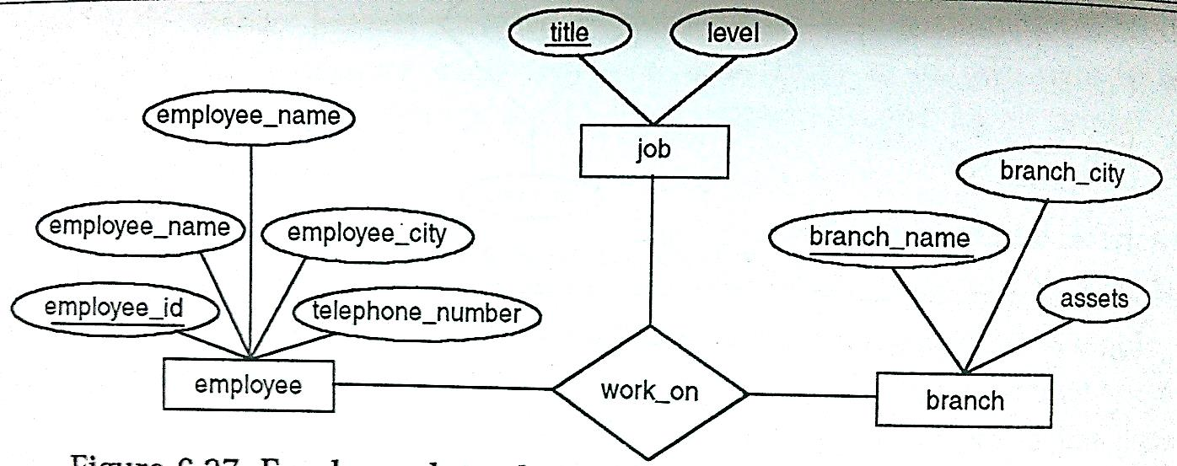
There is one advantage of using binary relationship, with this it is possible to store partial information but in ternary relationship it is not possible to represent it.
But there are some relationships that are naturally non-binary.

Slide 73
Design Issues: Placement of relationship attributes
The cardinality ratio of a relationship can affect the placement of relationship attributes
Example: Let us take two entities instructor and student with relationship advisor, if we want to add attribute date ( which specifies when the instructor became advisor)
If relationship is one to many then the date must be placed to the entity set on the “many” side of relationship
For one to one relationship, it could be placed on either side
For many to many relationship, the date must be placed as the relationship attribute

Slide 74
Create the table for employee having emp_name,emp_id,emp_address as attribute.
Alter the table with adding new column emp_dob
Modify the column emp_name as “char(40)”
Delete the column emp_dob from employee table.
Drop the employee table

